Slide 1
Final Presentation
GitHub: HTTPS://GITHUB.COM/MITTAL-AMAN7/BROWNIE_ASE
Gas Usage Anomaly Detector
Team No. 07
Pavan Sai Akula
Aman Mittal
Sai Sri Lakshmi Nannapaneni
Rukesh Sai Kasturi
Presented by
Notes:
I have made two title slides we can us

Slide 2
Steps Completed
02
Initialized the Data Repository
Captured Transaction Data
Identified Outliers in Gas Usage
Automated Detection and Notification

Slide 3
Analysis and Implementation of Data Repository
03
Database Setup: Utilizes psycopg2 for PostgreSQL connectivity to manage current_transactions and historical_transactions tables.
Functionality:
Table Creation: Includes functions to create tables if they don't exist.
Data Insertion & Retrieval: Functions to insert and retrieve transaction data.
Anomaly Detection: References an anomalies table for tracking gas usage anomalies.
Error Handling: Implements basic try-except blocks for database error management.
Script Execution: On running the script, it initializes the required tables.

Slide 4
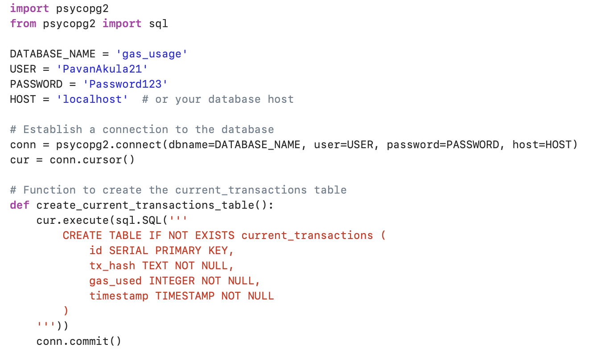
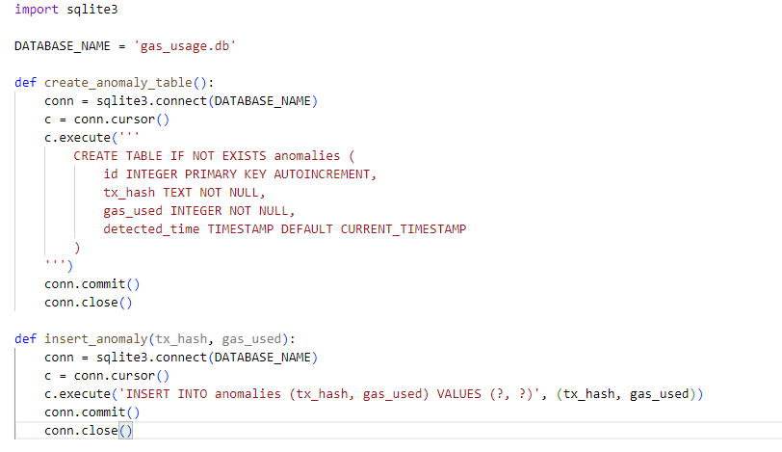
The Data Repository
04

Slide 5
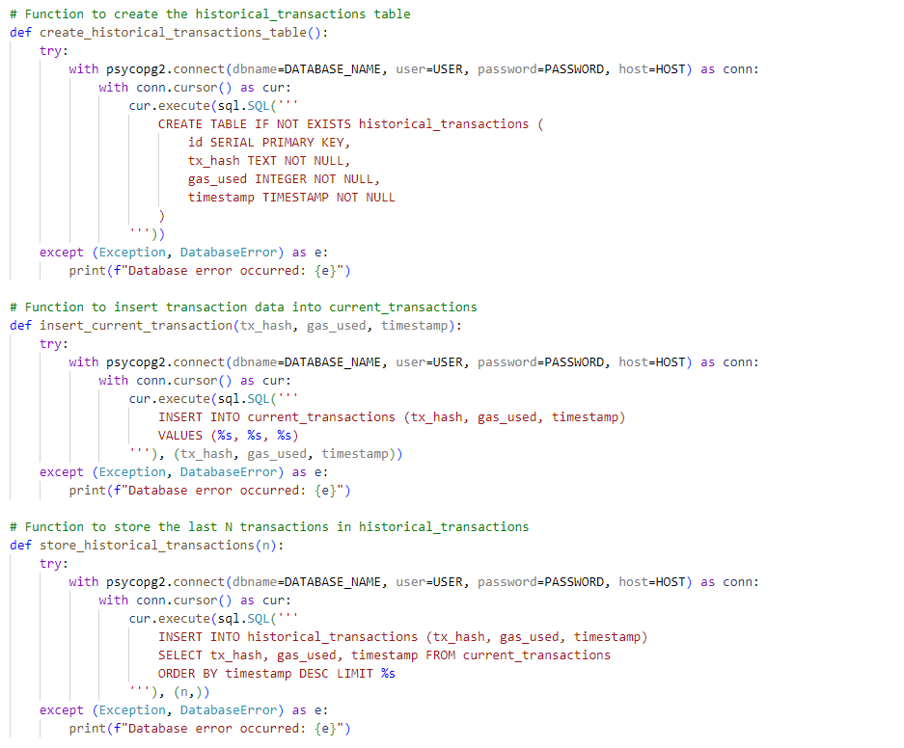
The Data Repository Cont’d
05

Slide 6
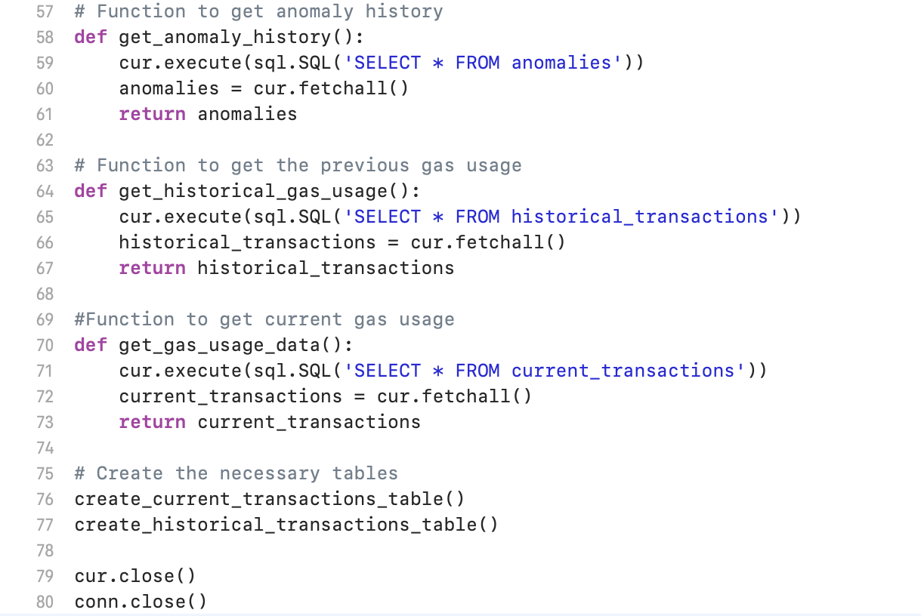
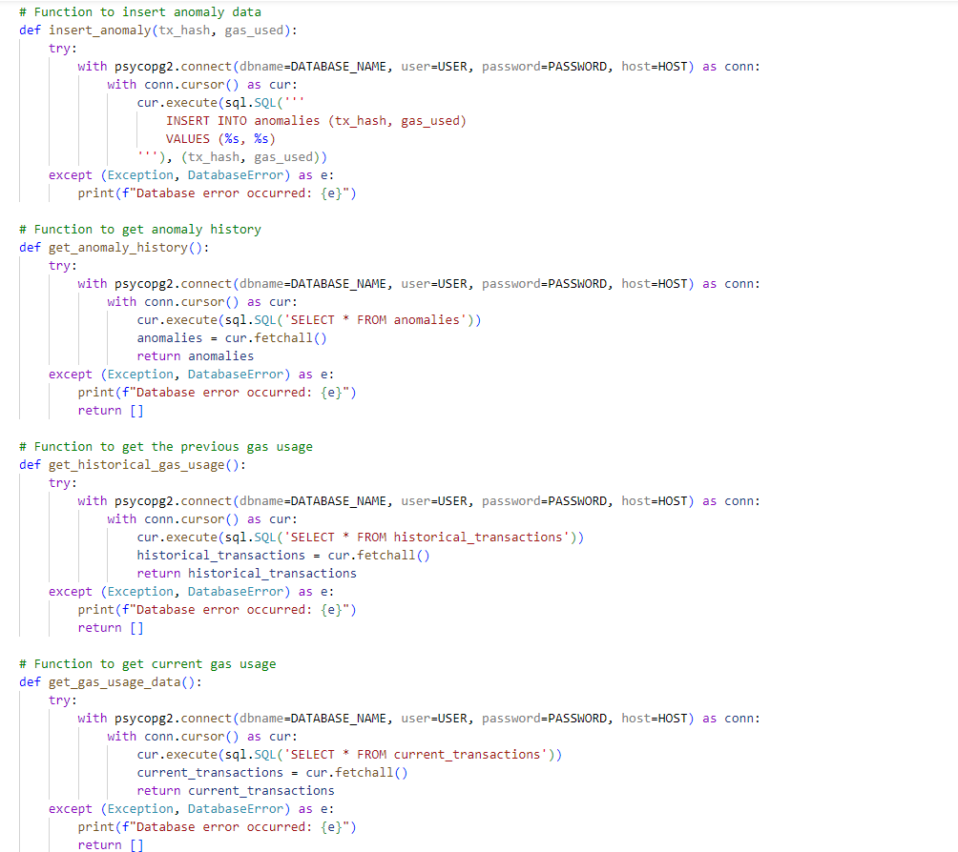
The Data Repository Cont’d
06

Slide 7
Captured Transaction Data( Data Gathering )
07
Connection: Uses Web3 to connect to Ethereum via Infura.
Data Collection: Fetches latest block and filters transactions for a specific contract.
Data Insertion: Stores transaction data in the database for gas usage analysis.
Error Handling: Manages connection errors and retries.
Execution Flow: Periodically runs to collect and update transaction data

Slide 8
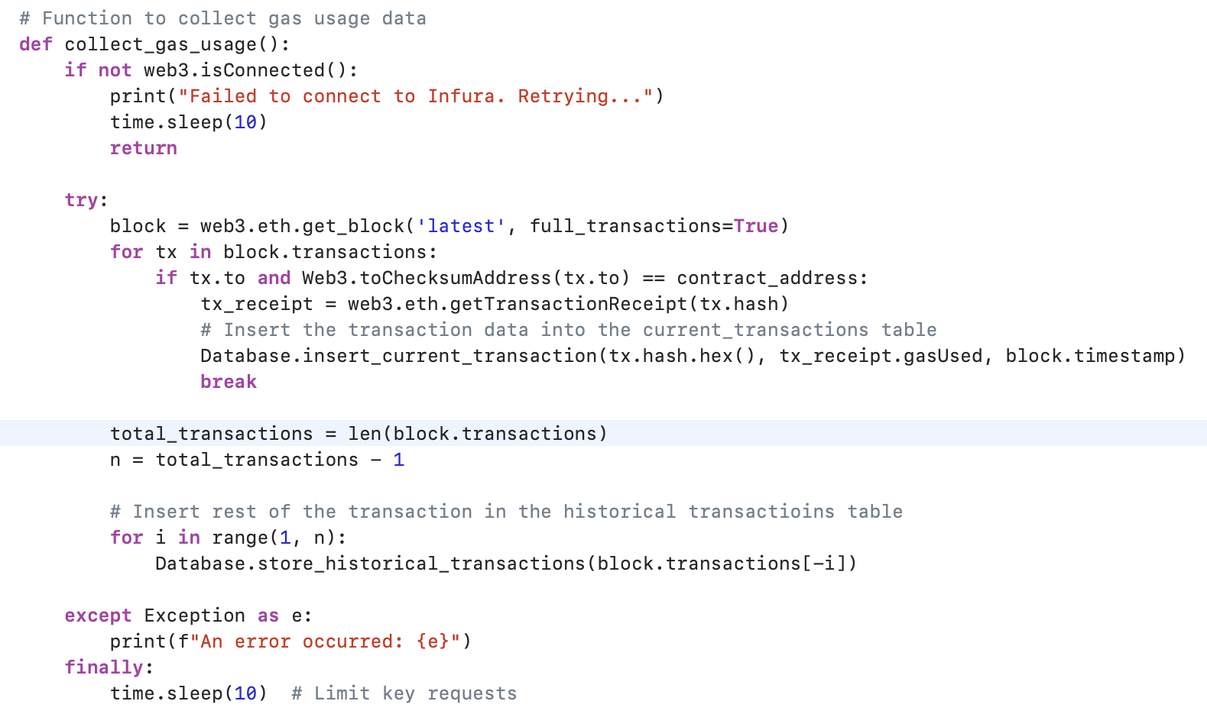
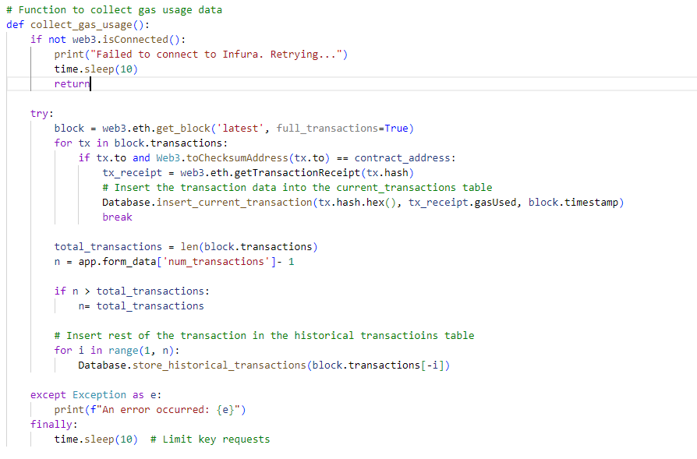
Captured Transaction Data( Data Gathering )
08

Slide 9
Identified Outliers in Gas Usage
09
Data Retrieval: Fetches current and historical gas usage data from the database.
Analysis: Calculates mean and standard deviation for historical gas usage.
Anomaly Detection: Identifies anomalies based on deviations from the mean.
Recording Anomalies: Stores detected anomalies in the database and sending an alert to the user.
Operational Flow: Periodically runs to update and analyze gas usage data

Slide 10
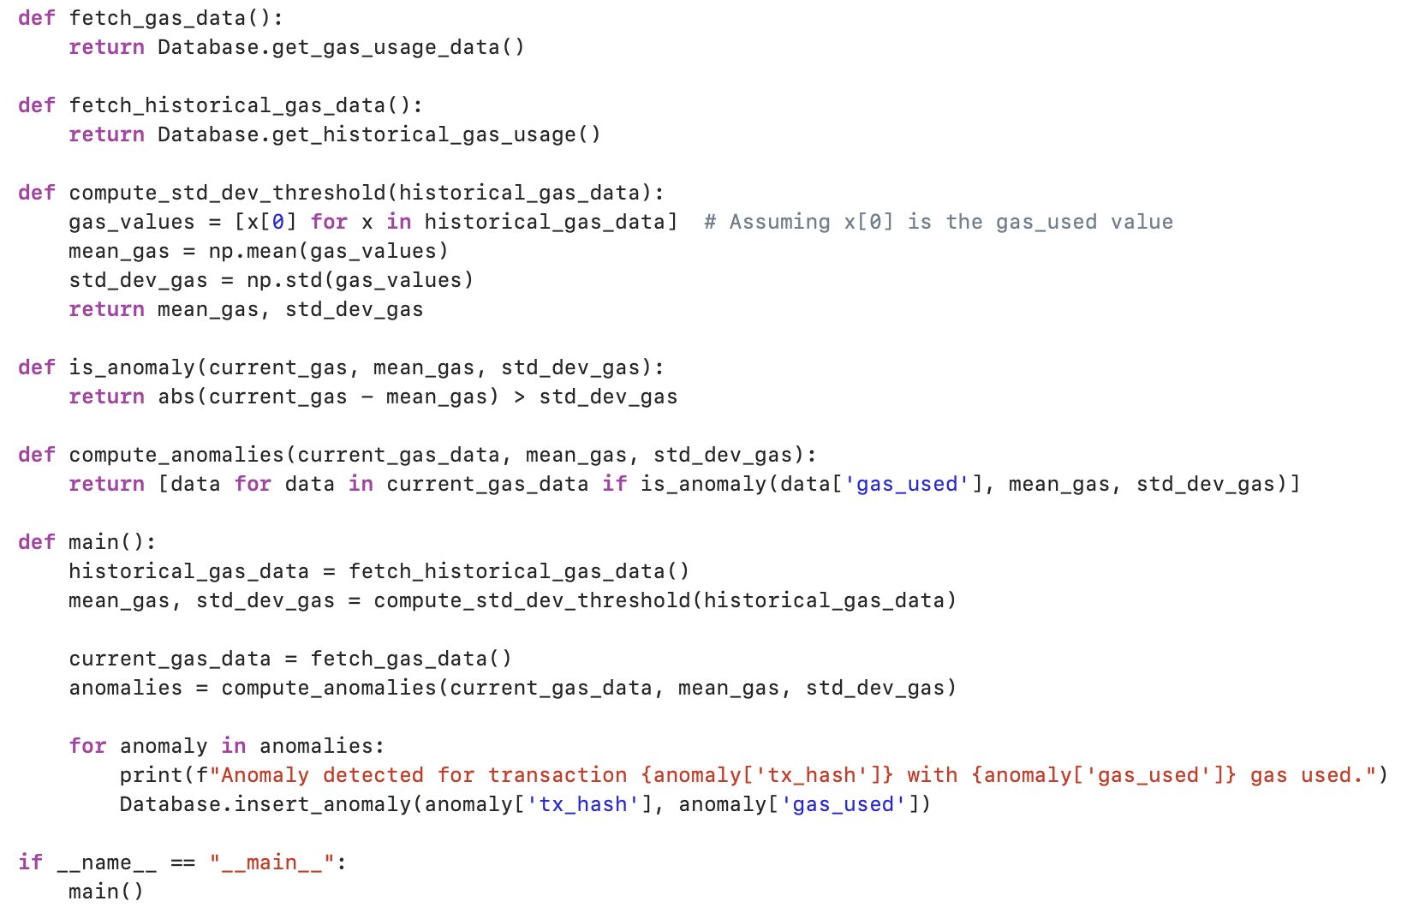
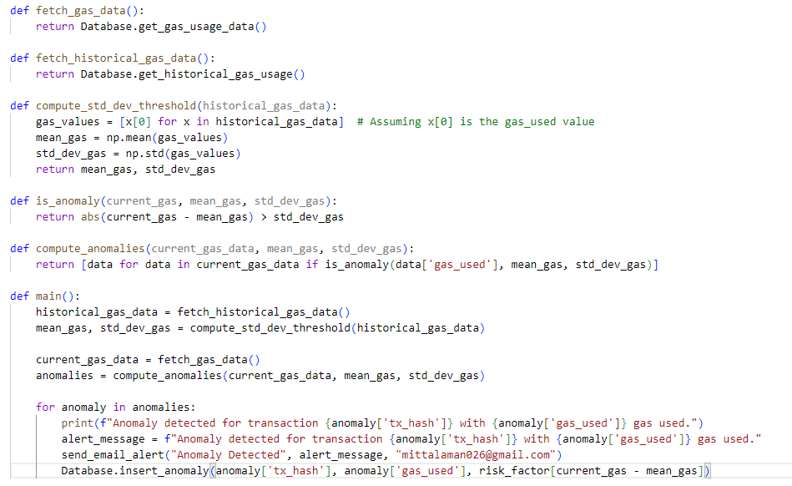
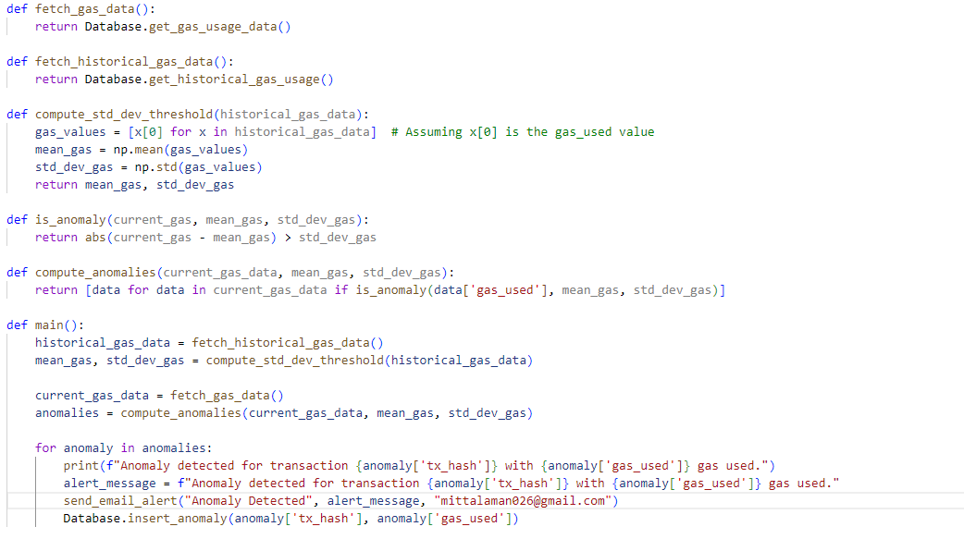
Identified Outliers in Gas Usage
10

Slide 11
Automating Detection and Notification
11
Email Configuration: Sets up sender email and password from environment variables.
Email Composition: Creates a MIME email with subject, message, and recipient details.
Server Connection: Connects to Gmail's SMTP server for email sending.
Sending Process: Logs in and sends the composed email, then closes the server connection.
Purpose: Designed to automate the sending of alerts based on detected anomalies or events

Slide 12
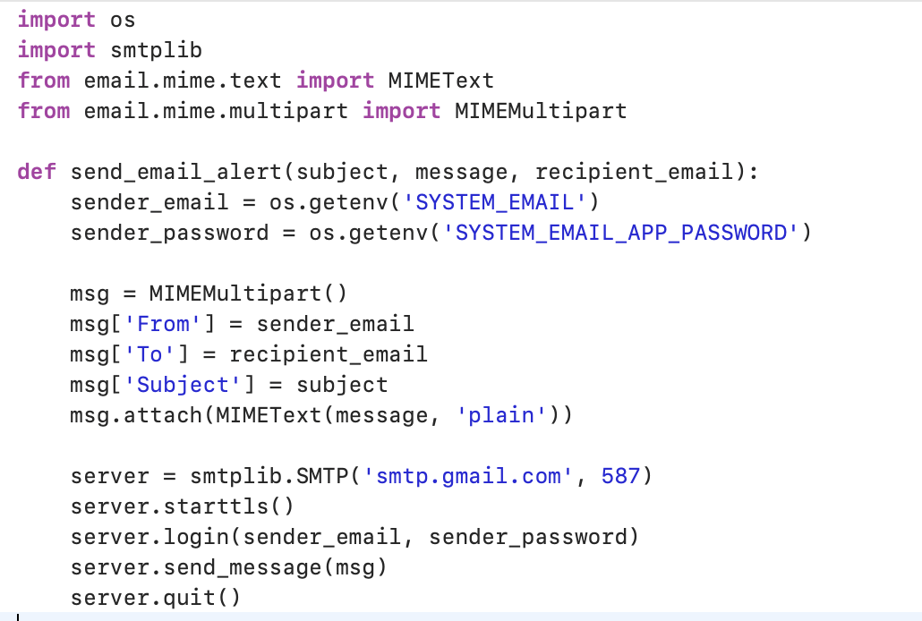
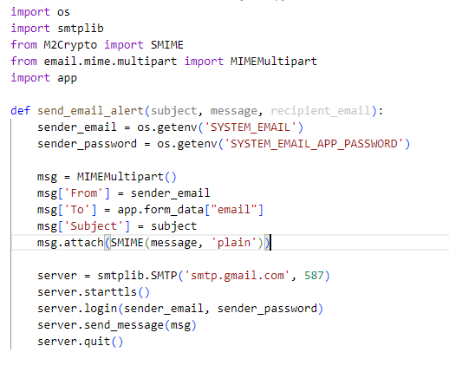
Automating Detection and Notification
12

Slide 13
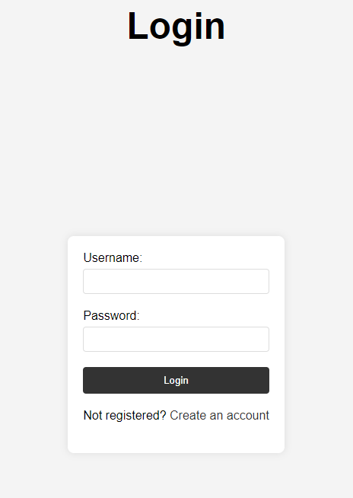
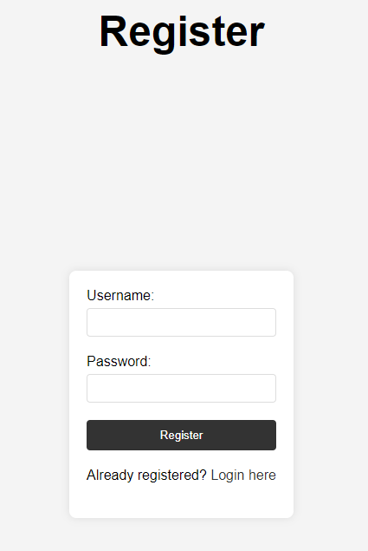
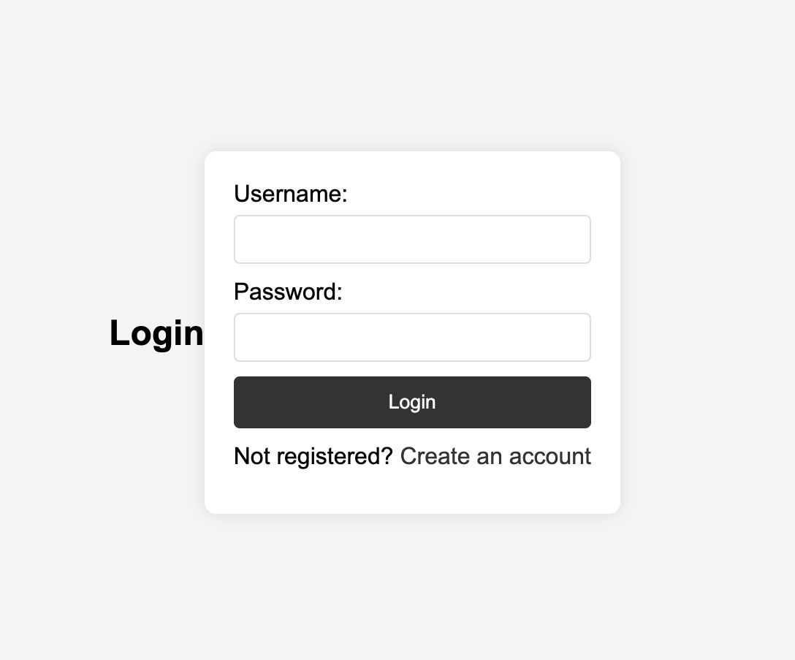
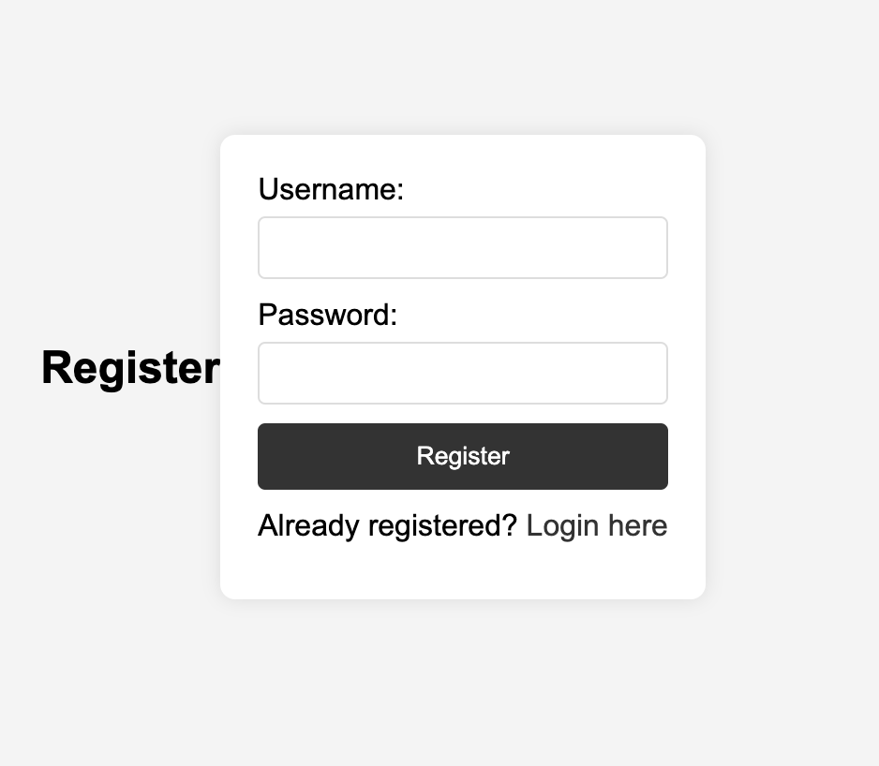
Enhancement
13
User Interface

Slide 14
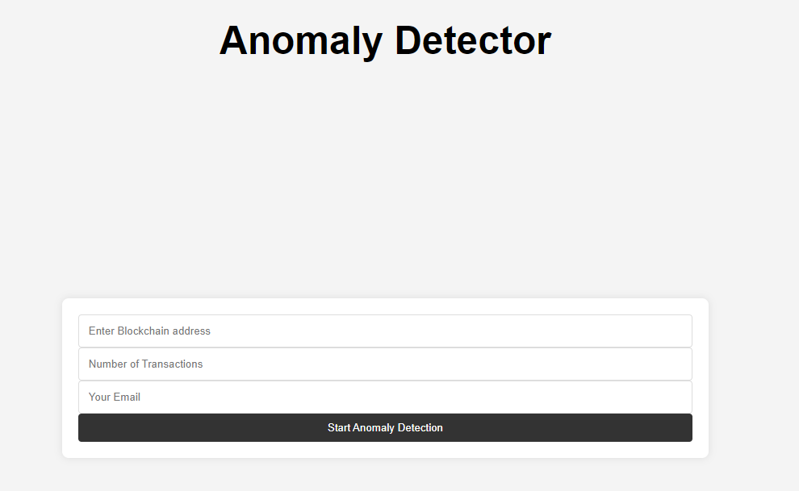
Enhancement
14
User Interface

Slide 15
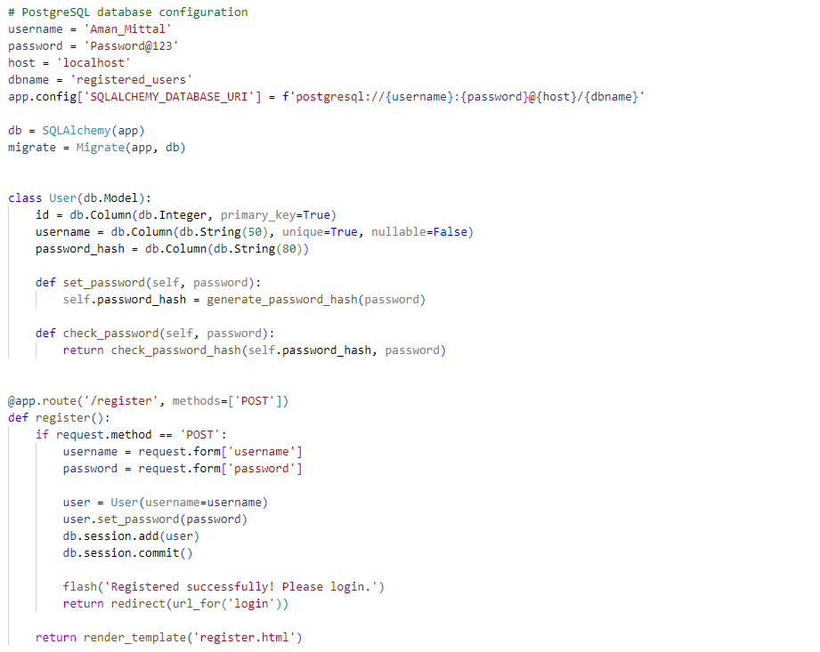
Backend
Back-End
15

Slide 16
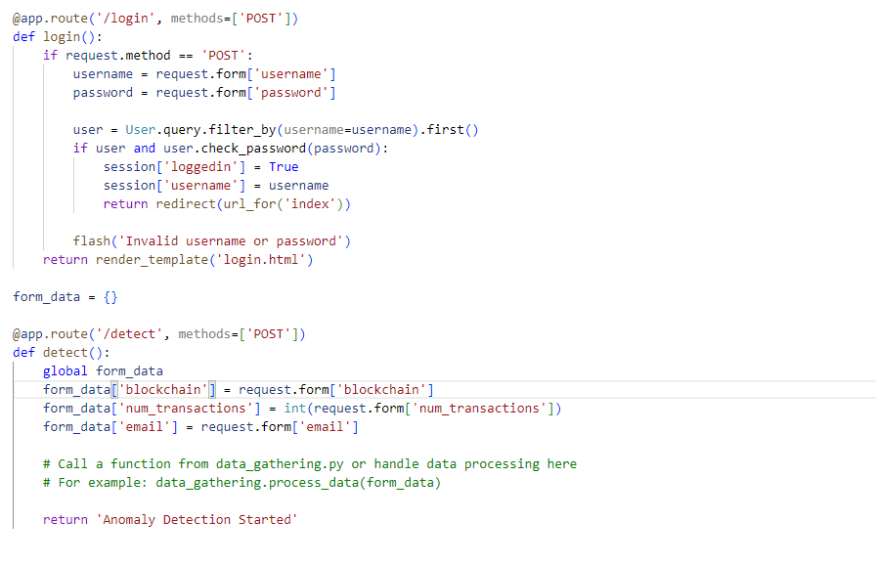
Backend
15
Back-End

Slide 17
How to Execute
17
We will be hosting the website that can be used to execute the detector.
User will need to provide the Ethereum contract information to check Gas Usage Anomaly.
To run the program locally we will need to initialize the database:
flask db init
flask db migrate -m "Initial migration.”
flask db upgrade
Then run the app.py in background to collect data provided by anomaly_form.html page.

Slide 18
Risk Exposure
18
Operational Risks: Inaccuracies in data collection or analysis could lead to false alerts or missed detections.
Security Risks: As a tool dealing with blockchain data, it's a target for cyberattacks, risking data integrity and confidentiality.
Technological Risks: Rapid changes in blockchain technology and Ethereum updates may require constant tool updates to stay relevant.
Compliance Risks: The tool must comply with evolving data privacy laws and blockchain regulations.
Notes:
Pie chart representing sales across four fiscal quarters. First quarter sales are 15%, Second quarter sales...

Slide 19
Related Applications
19
Blockchain Analytics Tools: Similar apps providing analytics for blockchain transactions, focusing on aspects like gas prices, block times, and network activity.
Smart Contract Auditing Tools: Platforms that perform automated audits of smart contracts to identify vulnerabilities and inefficiencies.
Performance Monitoring Systems: Tools specifically designed to monitor the performance of decentralized applications (dApps) on Ethereum, including resource usage
Notes:
Pie chart representing sales across four fiscal quarters. First quarter sales are 15%, Second quarter sales...

Slide 20
Customer Feedback
20
Positive Aspects:
Users appreciate The tool's ability to provide real-time monitoring of gas usage enabled prompt detection and resolution of irregularities. This not only streamlined their operations but also led to significant cost savings.
Areas for Improvement:
Users mentioned the need for more detailed analytics and customizable alert thresholds.
Feedback suggests a demand for better user interfaces and easier integration with existing development tools.
Overall Reception:
Generally positive reception, especially from users who prioritize smart contract efficiency and security.
Notes:
Pie chart representing sales across four fiscal quarters. First quarter sales are 15%, Second quarter sales...

Slide 21
CATEGORY | Tools and Technologies
Web3 Libraries | Web3.js , Ether.js
Data Storage | PostgreSQL
Backend Framework | Flask
Front-end Framework | HTML , CSS
APIs for Alerting | Email services , Communication Platforms
21
Notes:
Pie chart representing sales across four fiscal quarters. First quarter sales are 15%, Second quarter sales...

Slide 22
Summarize
22
The system implements an anomaly detection model to identify unusual gas usage patterns in transactions involving the specified contract.
It calculates the standard deviation and mean of gas used in historical transactions and flags any current transactions that deviate significantly from these statistics as anomalies.
We're developing a web application using the Flask framework that allows users to register and log in to access a specialized service.
The application uses ‘web3.py’ library to connect to the Ethereum blockchain via Infura, allowing it to read block and transaction data in real-time.
The application leverages PostgreSQL to store transaction data in Different tables.
Upon detecting an anomaly, the system triggers an alert mechanism.
Notes:
Pie chart representing sales across four fiscal quarters. First quarter sales are 15%, Second quarter sales...

Slide 23
Reference
23
https://www.postgresql.org/docs/current/tutorial-createdb.html Slide 5 and 6
https://www.prisma.io/dataguide/postgresql/setting-up-a-local-postgresql-database Slide 5 and 6
https://www.postgresql.org/docs/current/ecpg-errors.html Slide 5 and 6
https://www.dappuniversity.com/articles/web3-js-intro Slide 8
https://ethereum.stackexchange.com/questions/116945/how-to-get-full-info-of-a-transaction-hash-web3-py-or-web3-js Slide 8
https://www.geeksforgeeks.org/numpy-std-in-python/ Slide 10
https://www.w3schools.com/css/ Slide 13 and 14
https://flask.palletsprojects.com/en/3.0.x/ Slide 15 and 16
Flask Tutorial: https://www.youtube.com/watch?v=MwZwr5Tvyxo&list=PL-osiE80TeTs4UjLw5MM6OjgkjFeUxCYH Slide 15 and 16

